Slide 1

EE 258 Neural Networks Team Project Presentation Statoil/C-Core Iceberg Classifier Challenge (Kaggle)
Deepanshu Saini
Raghavendra Guna Shekhar
December 5, 2017
Department of Electrical Engineering

Slide 2
Background
Problem Statement
Drifting icebergs present threats to navigation and activities in areas such as offshore of the East Coast of Canada.
Currently, many institutions and companies use aerial reconnaissance and shore-based support to monitor environmental conditions and assess risks from icebergs.
How to use machine learning to more accurately detect and discriminate against threatening icebergs as early as possible
The model will be evaluated on the log loss between the predicted values and the ground truth as per the ICEBERG Classifier Kaggle competition rules.

Slide 3


Slide 4
Data Collection and Preprocessing
Tools Used
Scikit Learn , Keras , pandas , matplot library modules have been used to build the above prediction model.
The Dataset and labels are provided by human experts and geographic knowledge on the target. All the images are 75x75 images with two bands.
The data (train.json, test.json) is presented in json format. The files consist of a list of images, and for each image, you can find the following fields: id , band_1, band_2, inc_angle, is_iceberg
Since the Sentinal satellites gives us only two bands of Data(HH & HV), we append both the bands to generate a 2-channel equivalent.
Min-Max normalisation technique is used for the transforming the values in the range of 0 to 1 and remove the unnecessary features like id and incidence angle which do not affect the output label.

Slide 5
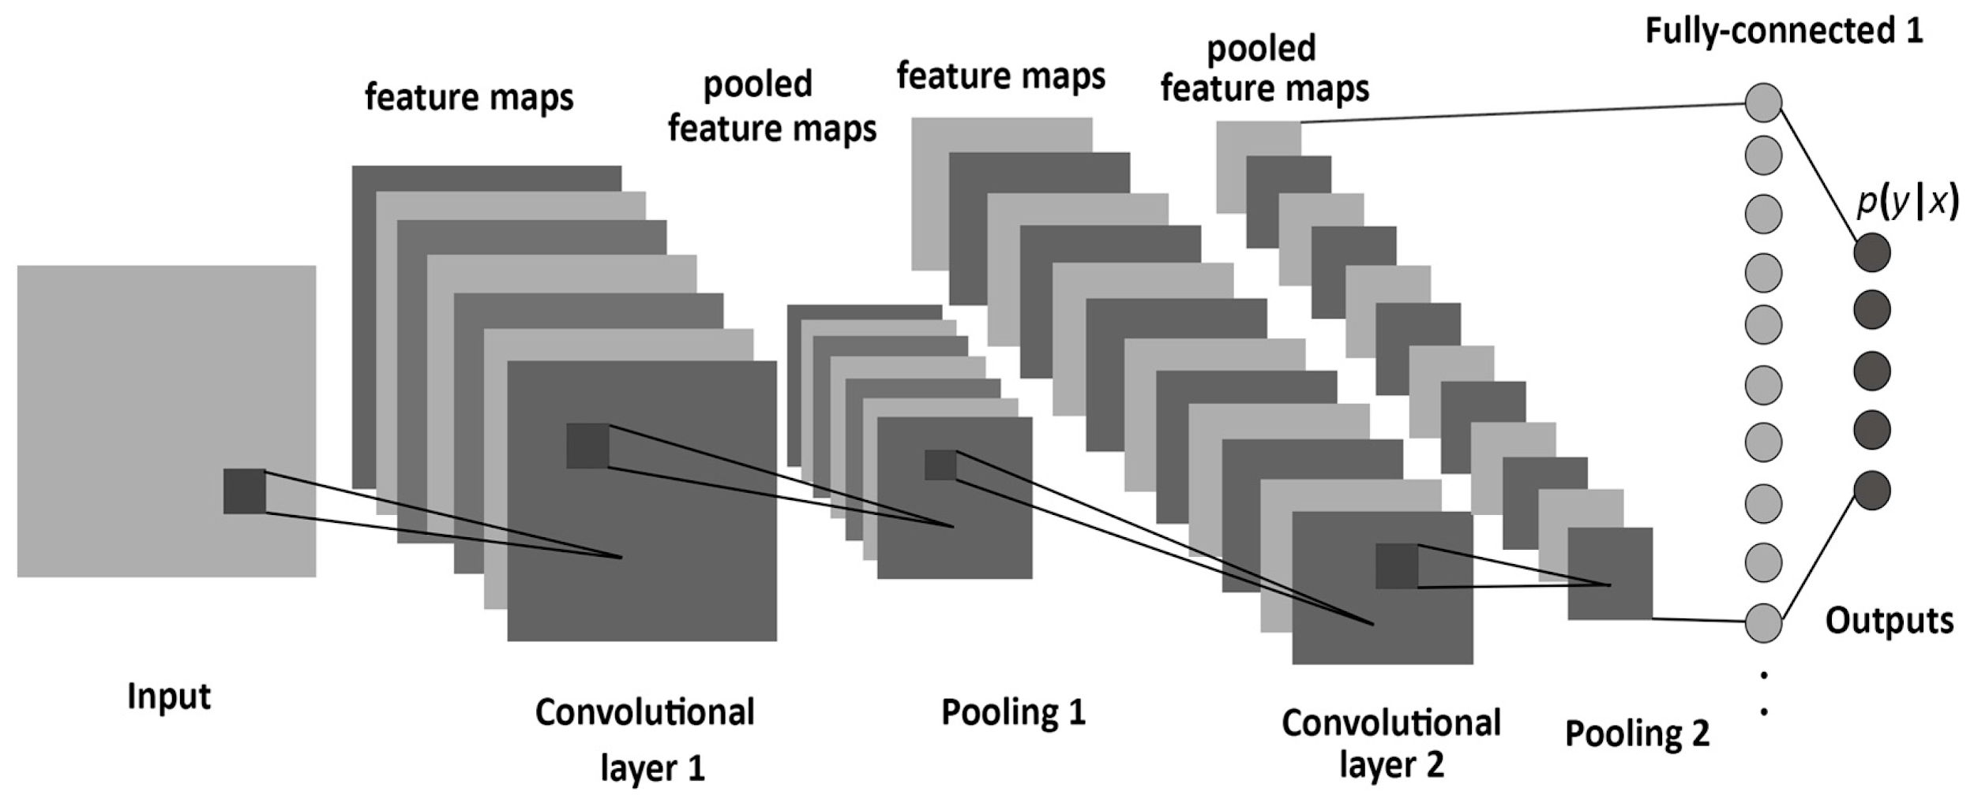
Kernel (Convolutional neural Network)
The CNN (Convolutional Neural Network) is deep learning algorithm that we use here to predict whether the given image is Iceberg or a Ship.
The General steps involved in :
Convolution
Max Pooling
Flattening
Full Connection
Design parameters selected for our model:
Convolutional kernel size= 3*3 , Pooling size= 2*2 , & Strides = 2*2 for both convolutional and pooling layer.
Convolutional and Pooling layer = 3 phases , number of hidden layer of fully connected Neural network= 2.
Activation function for Convolutional and Pooling phase & for Fully connected layer neurons except output neuron = LeakyRELU(alpha=0.1)
Activation function for only output neuron of fully connected neural network = softmax
Here we use Adam’s optimization technique for finding optimized loss function.

Slide 6
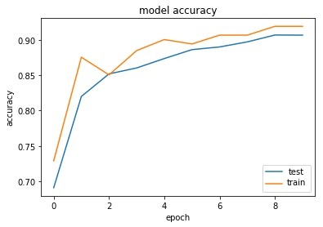
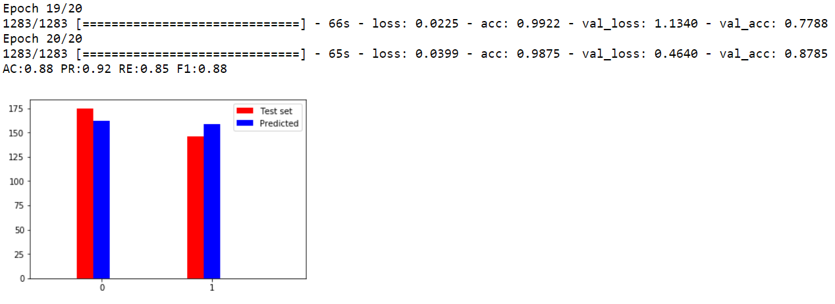
Results and Discussion
As we can see in the models’ accuracy graph besides, the CNN model overfitted the data as the train set accuracy is higher than that of the test set.
Also we can see in the screenshot of results below that the acc=0.9875 is higher than the val_acc=0.8785, which reflects overfitting as well.
The final accuracy score, precision score, recall and F-1 metric score of the model are also generated in the results below

Slide 7
Future Scope
Generate an 3 channel RGB equivalent, by using the average of 2 bands as the 3rd channel.
Using Data Augmentation techniques to improve Regularization
Algorithm Tuning by experimenting with the following hyperparameters:
Learning Rate
Activation Functions
Batch Size
Epochs
Training the CNN’s on GPU with modified number of neurons and layers of fully connected neural network.
Implementation of Ensemble algorithms which combines two or more algorithms for better accuracy.

